Slide 1

Presented By: Anusha

Slide 2
Topics
Introduction
Terminology
The Agile Manifesto
Some Agile Methodologies
Summary
References

Slide 3
What Is Agile
Agile --readiness for motion, nimbleness, activity, dexterity in motion
Agility
  The ability to both create and respond to change in order to profit in a turbulent business environment
    Companies need to determine the amount of agility they need to be competitive
Chaordic
  Exhibiting properties of both chaos and order
    The blend of chaos and order inherent in the external environment and in people themselves, argues against the prevailing wisdom about predictability and planning
    Things get done because people adapt, not because they slavishly follow processes

Slide 4
Agile Software Development
Agile software development is a conceptual framework for software engineering that promotes development iterations throughout the life-cycle of the project.
Software developed during one unit of time is referred to as an iteration, which may last from one to four weeks.
Agile methods also emphasize working software as the primary measure of progress

Slide 5
Agile Software Development: Intro
Characteristics of Agile Software Development
-- Light Weighted methodology
-- Small to medium sized teams
-- vague and/or changing requirements
-- vague and/or changing techniques
-- Simple design
-- Minimal system into production

Slide 6
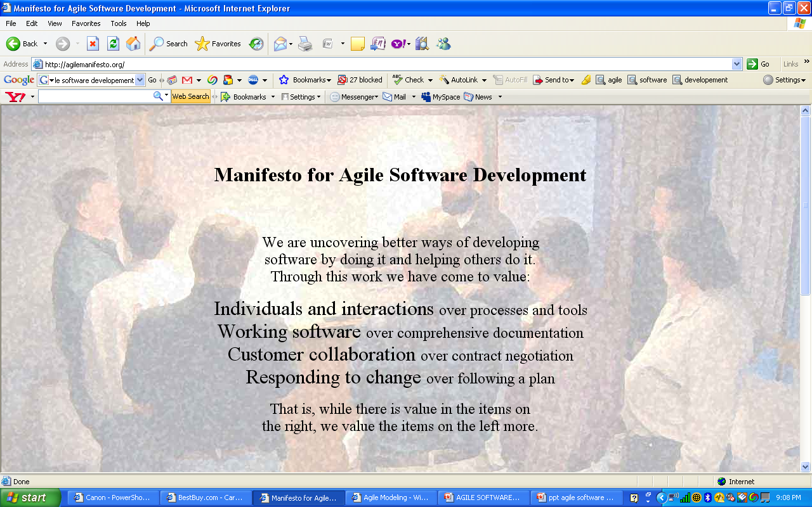

Slide 7
Characteristics
Modularity
Iterative
Time-bound
Incremental
Convergent
People-oriented
Collaborative

Slide 8
Existing Agile Methods
Extreme Programming (“XP”)
Agile Unified Process
Scrum

Slide 9
Extreme Programming
Most prominent Agile Software development method
Prescribes a set of daily stakeholder practices
“Extreme” levels of practicing leads to more responsive software.
Changes are more realistic, natural, inescapable.

Slide 10
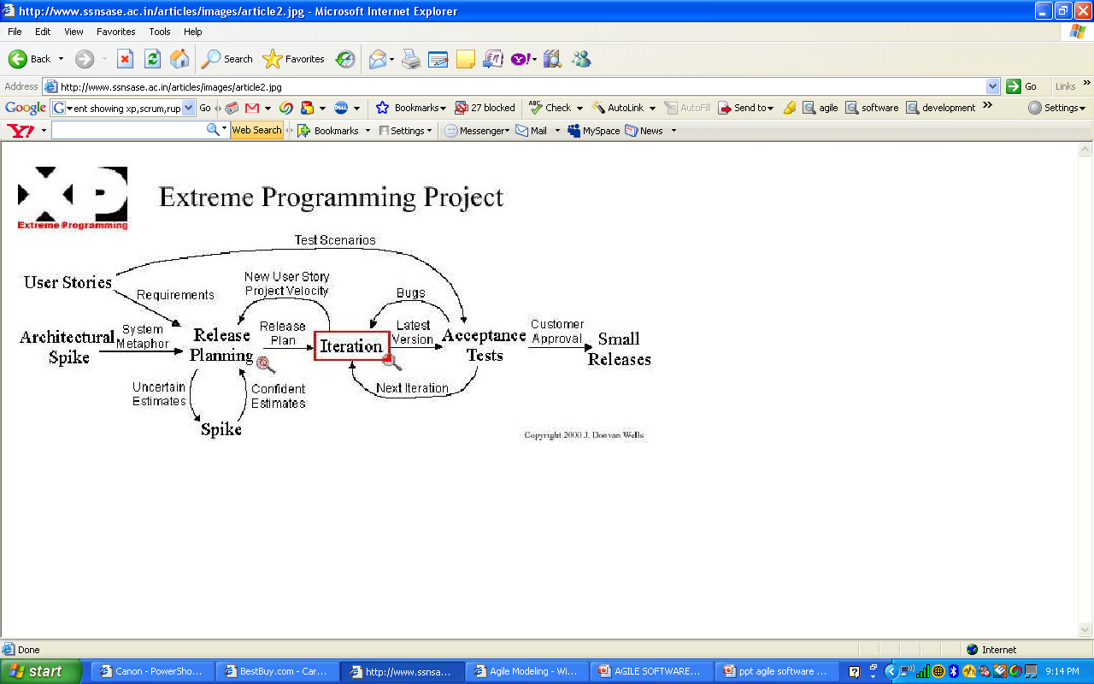

Slide 11
Agile Unified Process
AUP is a simplified version of RUP
Phases of AUP
Inception
Elaboration
Construction
Transition

Slide 12
Disciplines of AUP
Model
Implementation
Test
Deployment
Configuration Management
Project Management
Environment

Slide 13
Scrum
It is an Agile S/w development method for project management
Characteristics:
Prioritized work is done.
Completion of backlog items
Progress is explained
Agile Software Development

Slide 14
Conclusion
Synthesizes the existing literature.
Each method is described in terms of process, roles, responsibilities, practices, adoption and experiences.
Enables a selection criteria for comparing methods and pointing out their differences.

Slide 15
References
[1]. Abrahamsson P, Salo O and Ronkainen J. Agile software development methods (Review and analysis).
[2]. Scott W Ambler. Agile model driven development.
[3]. Cohen D, Lindvall M, Costa P. Agile software development.
[4]. http://en.wikipedia.org/wiki/Agile_Modeling.
[5]. http://en.wikipedia.org/wiki/Extreme_Programming.
[6]. http://en.wikipedia.org/wiki/Agile_Unified_process.
[7]. http://en.wikipedia.org/wiki/Scrum_28development29.

